Slide 1
Rabbit Talk
By Timi
I created this because we have to talk about me getting a rabbit.
“How can we talk through PowerPoint” You might ask?
I have a system.
I suggest an idea, and you draw a tick in the boxes provided.
And there will be space for your ideas.
You can pick one suggestion, either mine or yours.

Slide 2
Oman
This is really messing up our schedule. Ideally, I’d buy the bunny this weekend, but the Oman trip disrupts that. We can only buy it at weekends, so going can delay us a whole week. Even if we don’t go this week, and buy the bunny we will need a pet sitter when we go to Oman. Have you got a solution? Write it down.

Slide 3
Housing
Yes | No
The bunny lives in my room, in a cage and a pen.
2. Bunny in my room, in a bunny condo. Diy. You can’t buy bunny condo.
Your ideas::

Slide 4
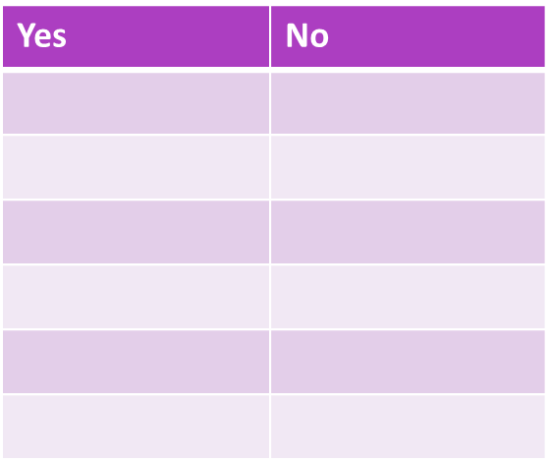
Finance
You pay for everything.
I pay for everything.
You pay for food, litter, hay and hutch, I pay for toys and whatever else… within my money

Slide 5
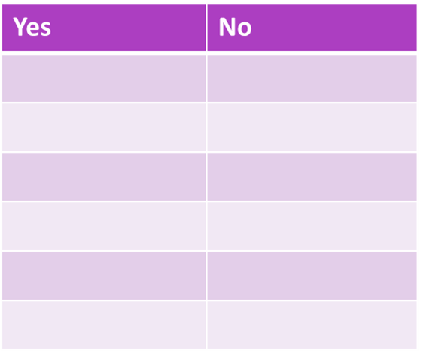
When I’ll Get Him/her
This Weekend
This Weekend
Next Year… Just kidding. This Weekend.

Slide 6
Where are going to get it?
1. Qaws Shelter (Not sure they have rabbit though.)
2. https://en.mzadqatar.com/Qatar/1299/Rabbits
Definitely have rabbits.

Slide 7
Thank You For Watching and Ticking

