Slide 1
Rabbits
By Timi, for a good cause you will find about on page 2.

Slide 2
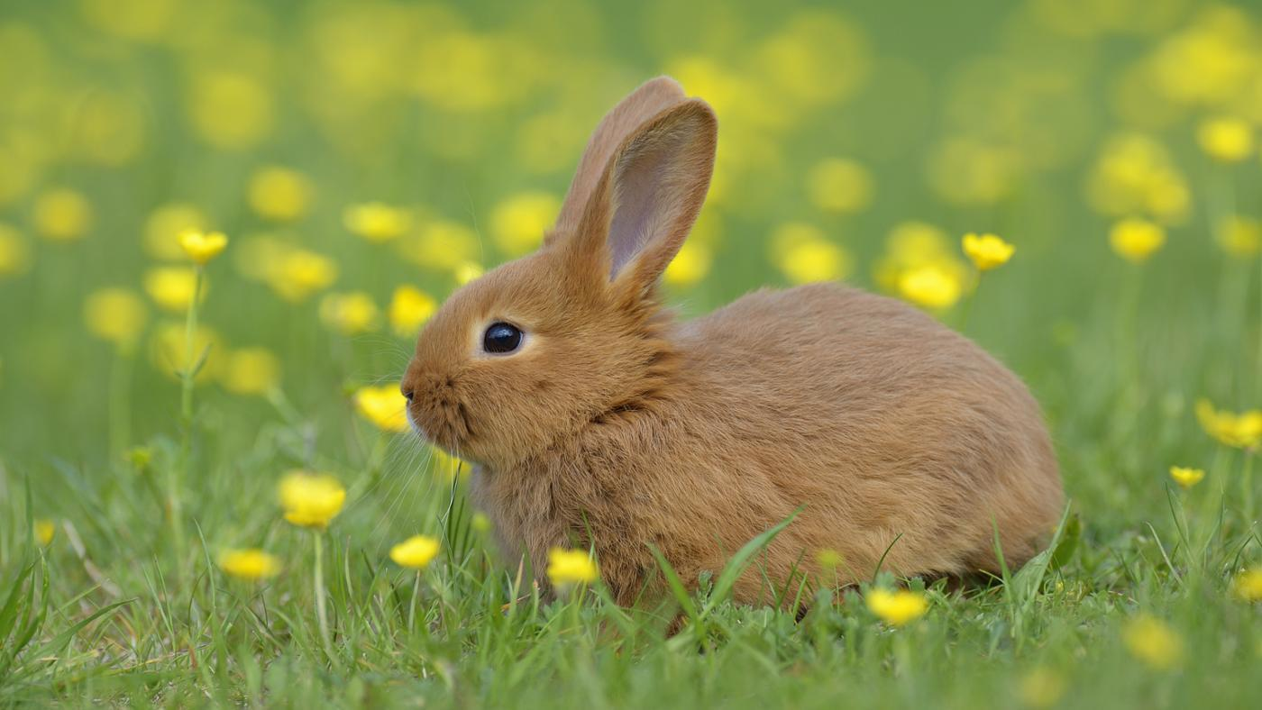
Can I get a rabbit?
Please. That sounds shocking and maybe impossible, but is actually a lot easier than it looks. I did a lot of research, and it won’t be bad, like you think. It will be awesome. For both me and Martin. Read the next pages as proof.

Slide 3
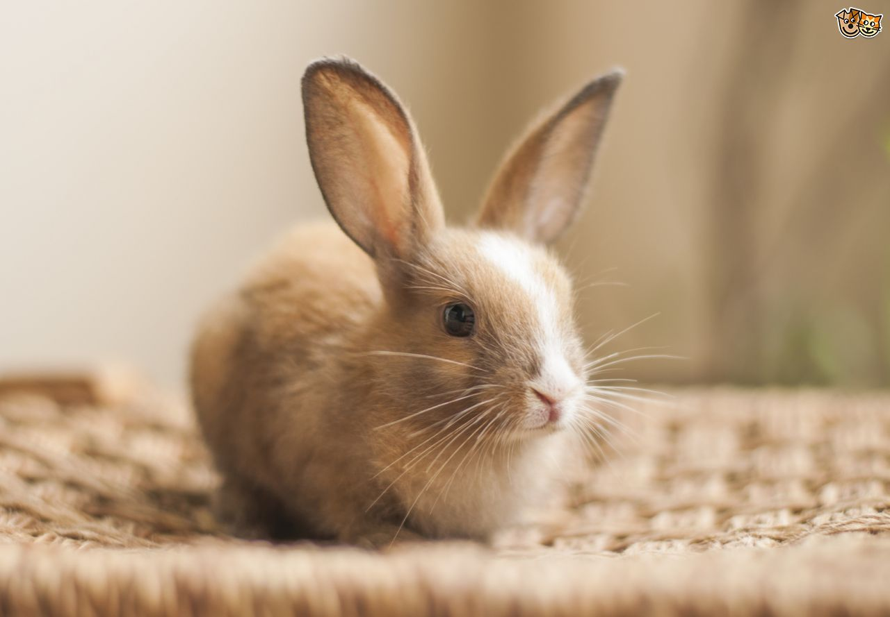
Why A rabbit?
Rabbits have strikingly distinctive personalities. They can be as playful and silly as puppies or kittens, as independent and fascinating as cats, or as loyal and openly affectionate as dogs. And long-time rabbit owners claim that domestic rabbits are, in their own way, every bit as smart as cats and dogs. Plus, they are very clean, cute and amazing.

Slide 4
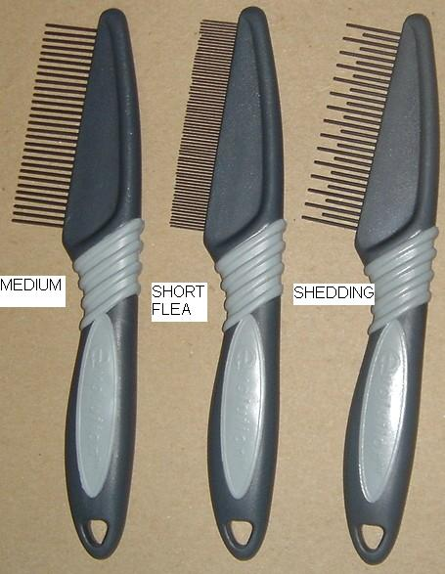
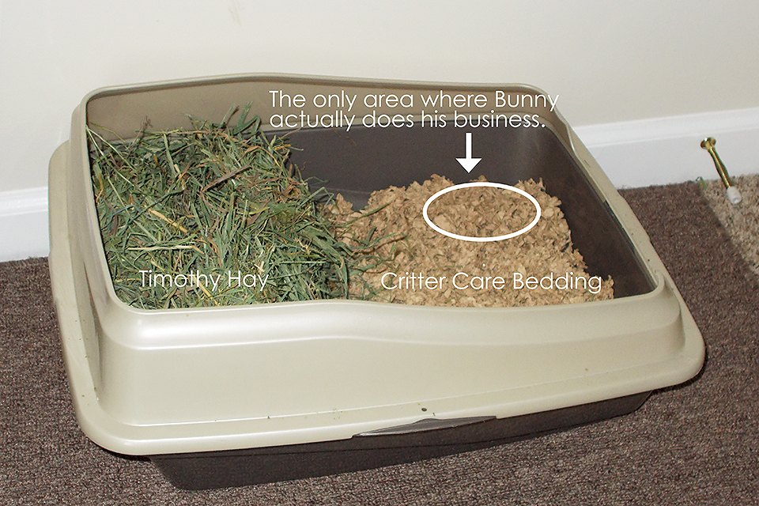
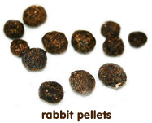
Who? Plus tidbits!
I will be the one taking care of the bunny. They will soon became litter-trained, and rabbits do not smell. RABBITS DO NOT SMELL. Not even their poop smells. They groom themselves real well, and I will also groom them.

Slide 5
Getting A Rabbit
I believe we should adopt a rabbit. Buying a rabbit is not good, because they treat them badly. Plus, adopting a rabbit is supportive and cheaper. I found a website that adopts rabbits and works in Qatar! ( It took me like 2 hours to find a good one.)
http://mohrs.org

Slide 6
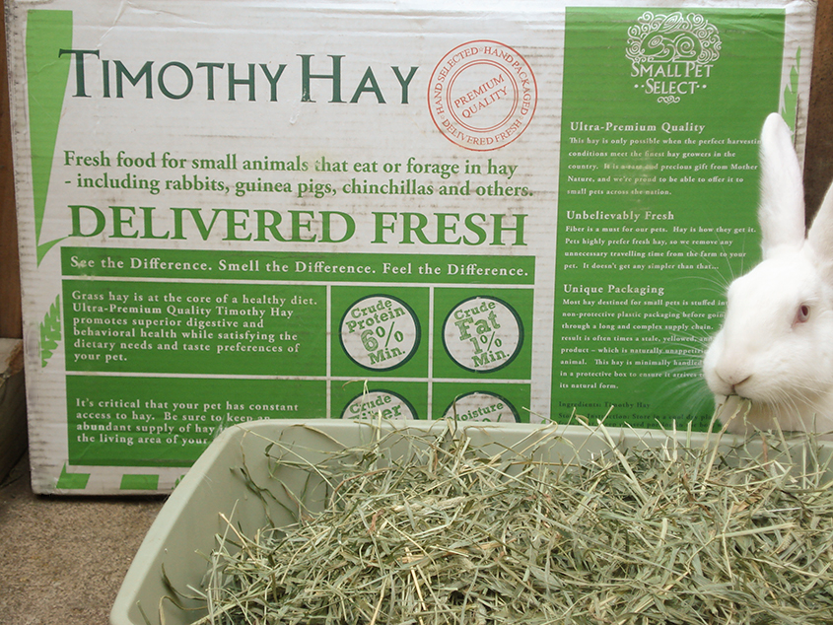
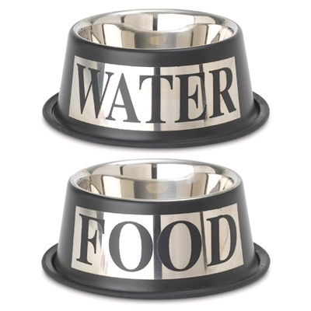
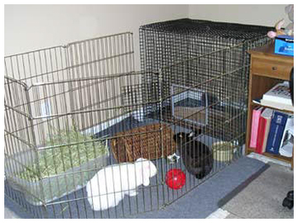
What we need…
A cage/pen (preferably pen)
Water/Food Bowl
Rabbit Safe Litter
Litter Box
Hay
Fresh Veggies
Rabbit Proofing Supplies
Grooming and Cleaning Supplies
Medical Items

Slide 7
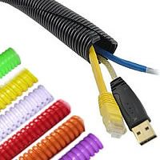
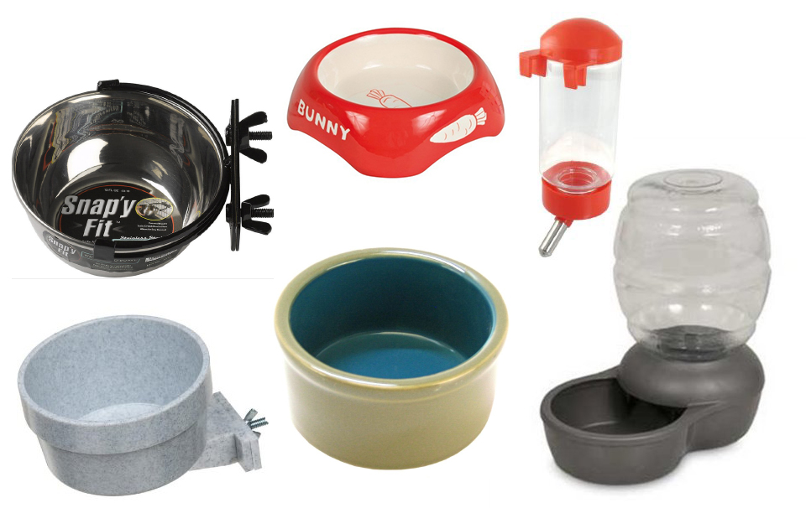
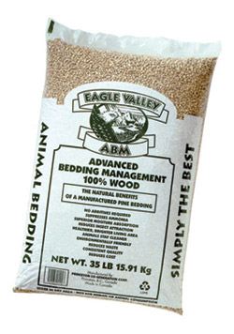
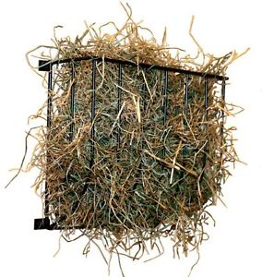
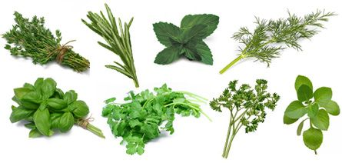
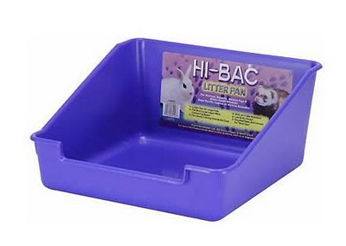
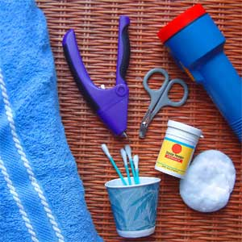
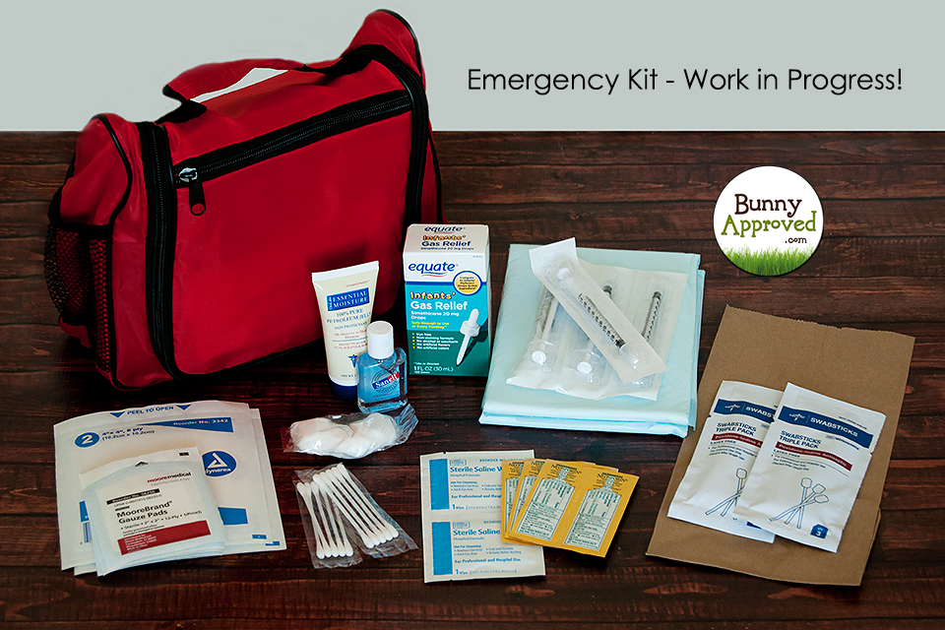
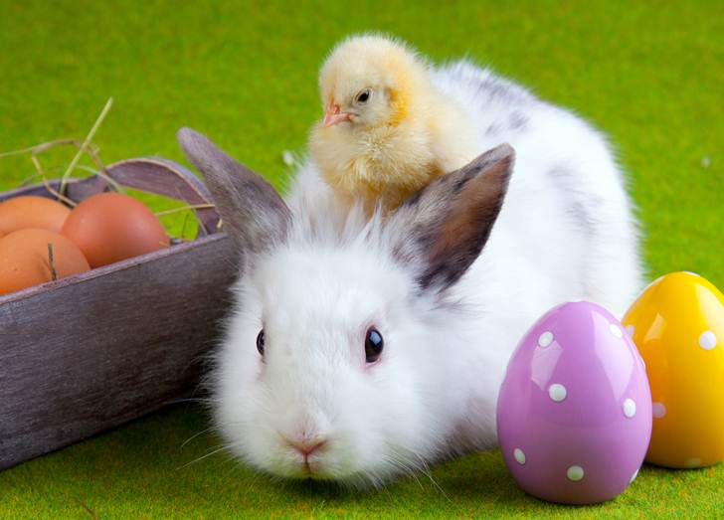
The Items-Pictures

Slide 8
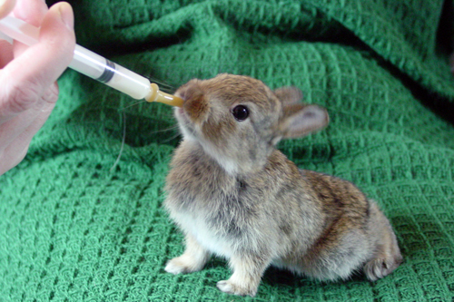
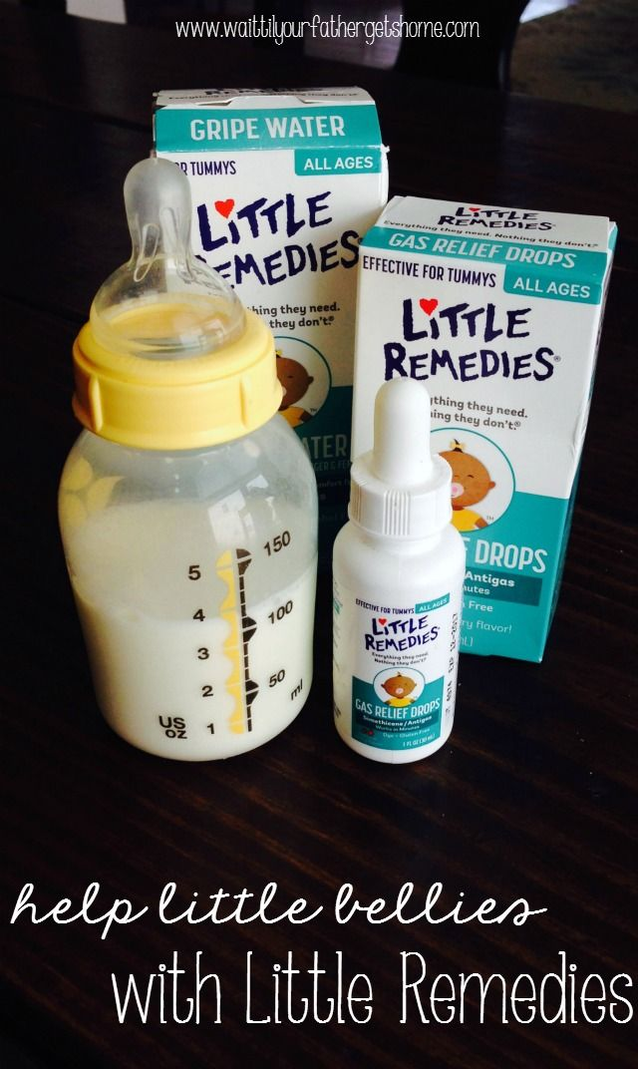
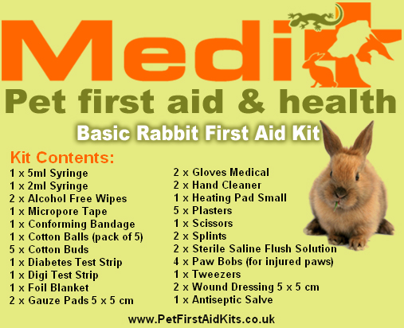
Medical Items
I can see you thinking; “what medical items?”. Actually it is not as complex. Here is the list of supplies:
Syringe ( to syringe feed if rabbit not eating, can be bought at hardware store)
Dried Pineapple ( to give as treats, they contain enzymes good for their digestive system)
Baby Mash Food ( If your rabbit can’t eat properly. Carrot-flavored.)
Gas Relief (It helps with digestion. Just put on food, is tasteless.)
Critical Care food ( to help the rabbit not feel sick)
Most these things are easily available.

Slide 9
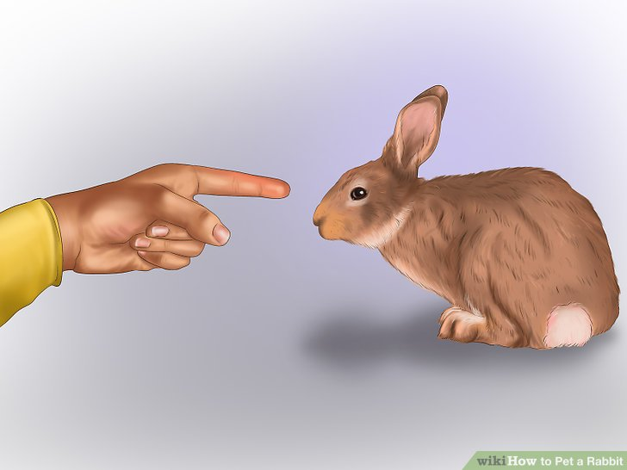
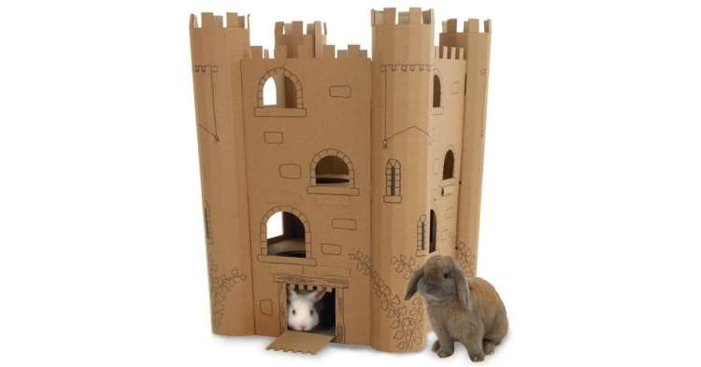
Taking A Rabbit Home
Rabbits are transported in simple boxes.
At home, you have to put the rabbit in the pen, and leave it for a day or so (with food, obviously) then it will slowly start getting used to you. You can’t reach for it, or reach for it from the back, those actions will scare it. You have to wait it to come to you.

Slide 10
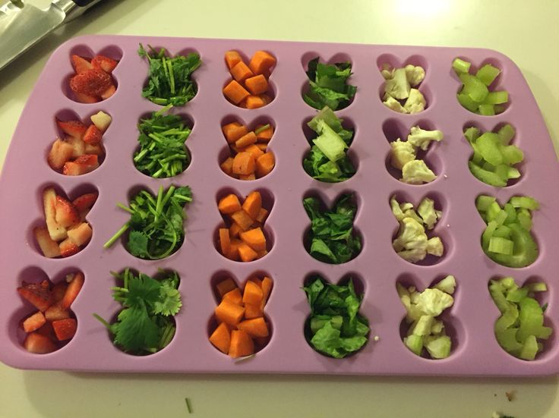
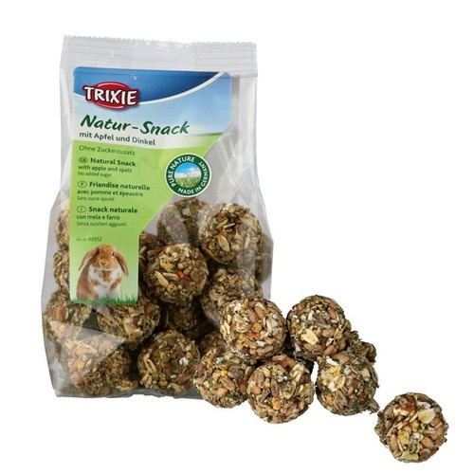
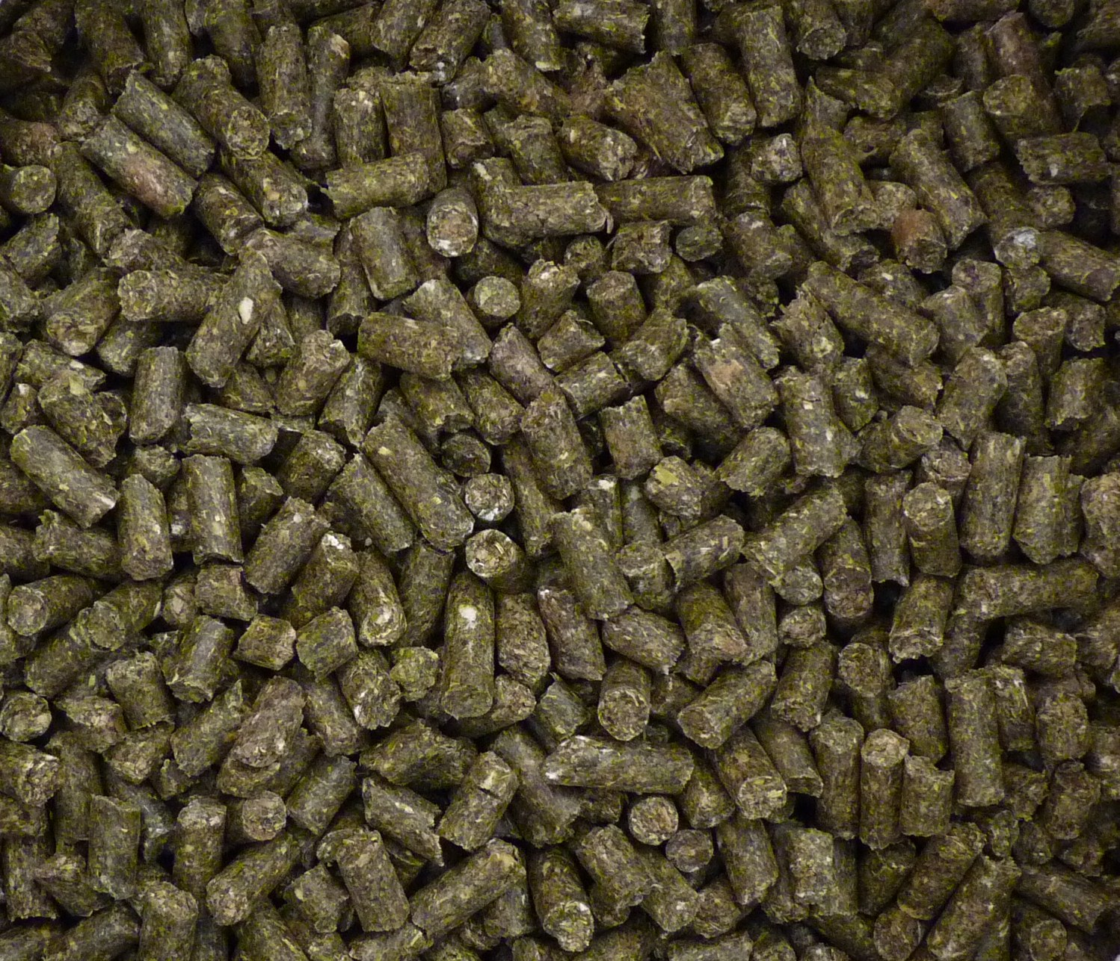
Food
Rabbits need a lot of types of food, here are they:
Unlimited Water
Pellets (for adults, oxbow, 1/8 cup for adults.)
Fresh Veggies ( One cup per 1.3 kg)
Unlimited Hay ( Timothy is good)
Treats (not every day, occasionally)

Slide 11
Daily Munch

Slide 12
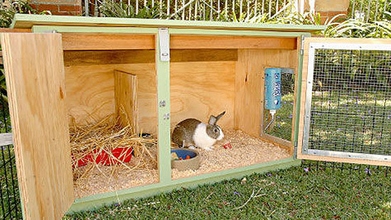
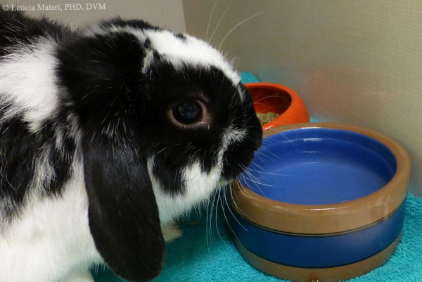
Daily Routine
I am going to make a huge sacrifice- wake up at 5:30 and go to sleep at 9:00. This is necessary, because I will replace the bunny’s food and water after breakfast, than wash, than clean the bunny’s cage. I will achieve this by timing my phone to wake me up. I WILL NOT FORGET AND DO IT ALL.

Slide 13
Coat & Nails & Smell
Rabbits have to be groomed about 3 times a week. This will be done by me and is just like brushing and cutting hair.
Rabbits have to have their nails cut. This is done by a vet.
Rabbits should be spayed or neutered. It stops them smelling.

Slide 14
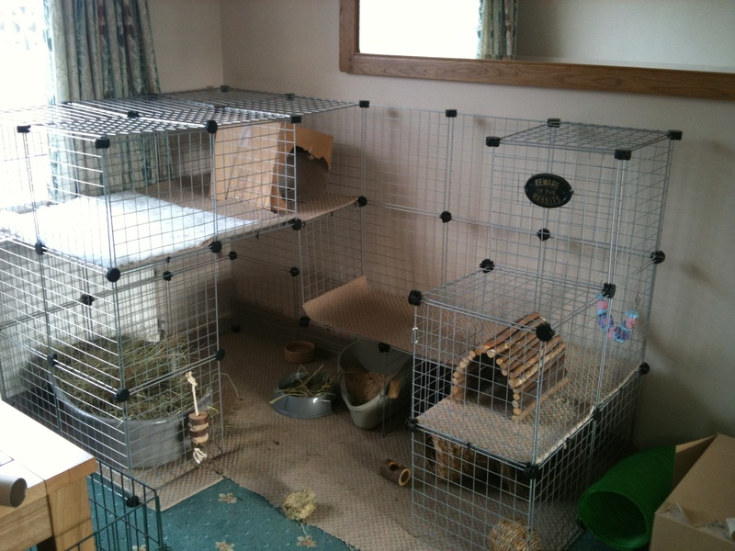
Where Will it live
The pen will go in the storage room or my room. Like it?
Any other ideas are welcome.

Slide 15
Bunny-Proofing
This really depends on where it will be, but the basics:
All wires have to have “critter protectors”.
No stuff on the floor. No more messy bathroom
Book Protection
No food/clothes on floor. It would eat both.
No perfume.
I’m sure we could live with that.

Slide 16
Finance
I will pay for it all. (But could you please pay for the veggies and the cost of buying it and the pen and you-know-what.)
The you-know-what will cost approximately maximum 371$- that’s 1350.96 QR. Luckily that’s the maximum. Probably. Sorry

Slide 17
Pros And Cons
Crepuscular ( Most active at Dusk and Dawn)
CUTE! CUTE! CUTE!
Lots of Breeds
Clean Animals
Can Be Litter-trained
Different Personalities
So Funny and Fun
Can be taught to do tricks.
Quiet
Eco-Friendly
Teach Responsibility
Long Life Span
Destructive ( give toys)
Kind of Messy
Lot of Work and Time
Expensive
Dislike Being Picked Up
Take Up Space

Slide 18
Vacation
This, the one reason I can’t get a rabbit, will disperse. For short vacations, we can hire a pet sitter to look after it. For summer vacation, we can take it with us. It can’t go to Iceland and stuff, but it can stay in Czech Republic and then move to Romania.
The pet sitter website:
http://www.petsitterqatar.com

Slide 19
Affect
This is a 10 year commitment, but it will be really good for me.
I will be joyful and happy, as it will be comforting when I’m sad.
I will become really responsible, which will help in my schoolwork.
It will be really good, for the environment, as the leftover, dirty hay can go to a compost, which we should make.

Slide 20
The answer
Give me your answer, on a word document and save it on this USB in ‘Open This’. Name the document ‘The Answer-Dad’ If the answer is yes, just write yes. If it is no, tell me why so I can answer that questions.
Then give to mum. She will do the same, but write ‘ The Answer-Mum’.

